Slide 1

L2: or How I learnt to stop worrying about scaling and love Ethereum!! <3
Haresh Gedia

Slide 2
Agenda
02
Refresher
2. Scaling & Blockchain Trilemma
3. Early scaling attempts
4. Layer 2’s
Optimistic
Zero Knowledge

Slide 3
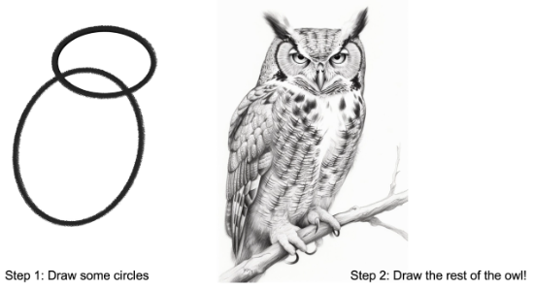
Format
02
Step 1: Principles/Truths.
Step 2: Finer details.
1

Slide 4
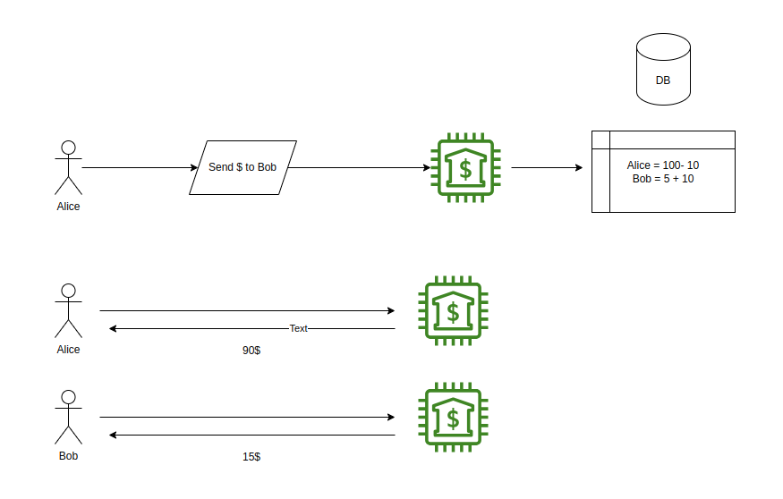
03
Refresher on Blockchains…
First there were banks….
Decentralized?
Scalable?
Secure?

Slide 5
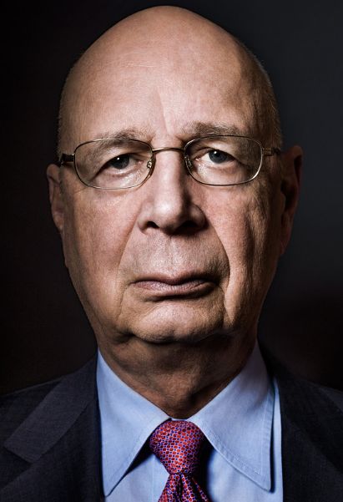
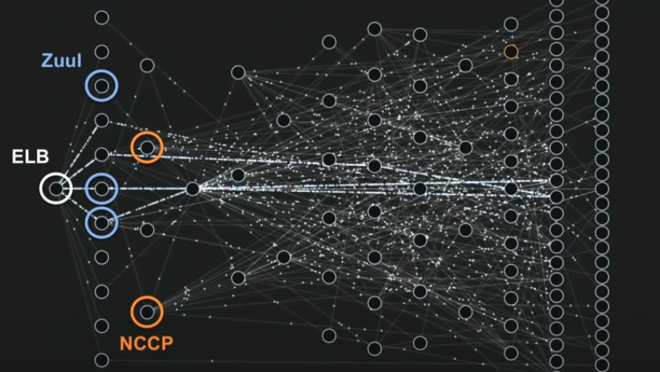
03

Slide 6
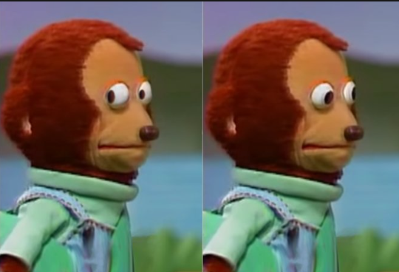
03
Decentralized?
Erm…kinda no
Secure?
Erm…kinda..
Scalable?
Erm...kinda

Slide 7
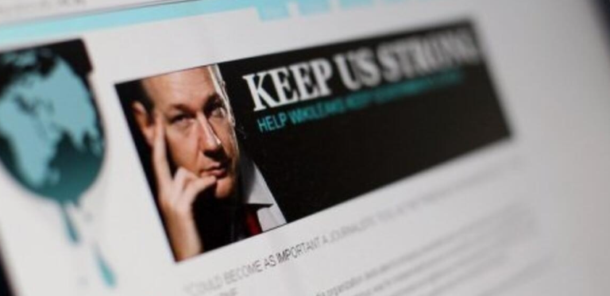
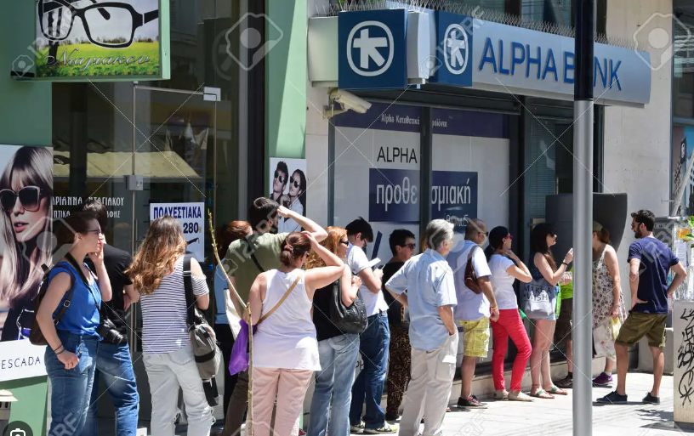
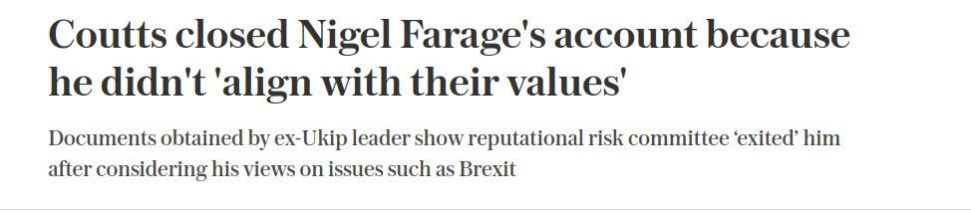
03

Slide 8
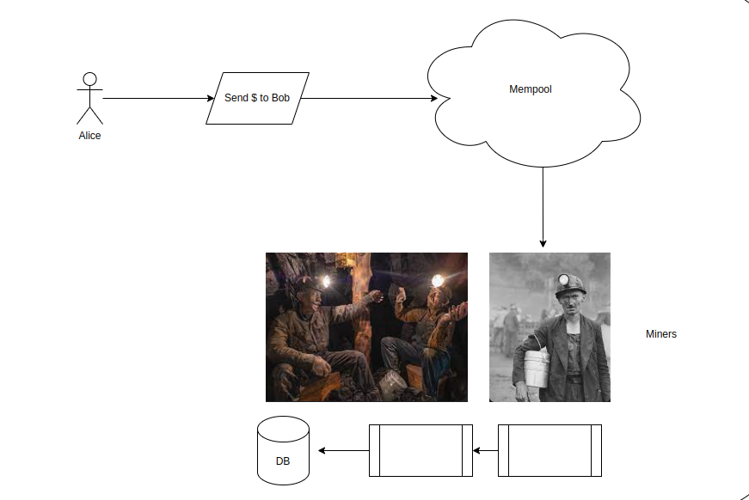
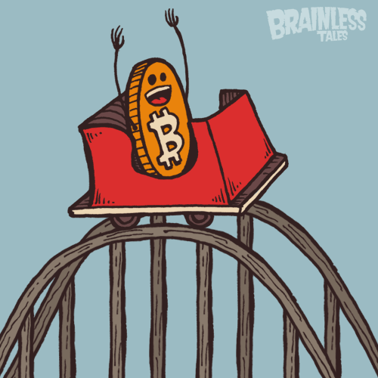
03
Hello Blockchains!!

Slide 9
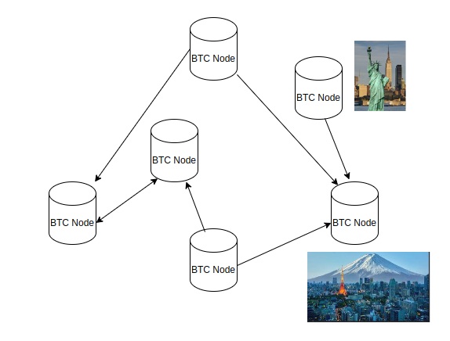

03
Decentralized?

Slide 10
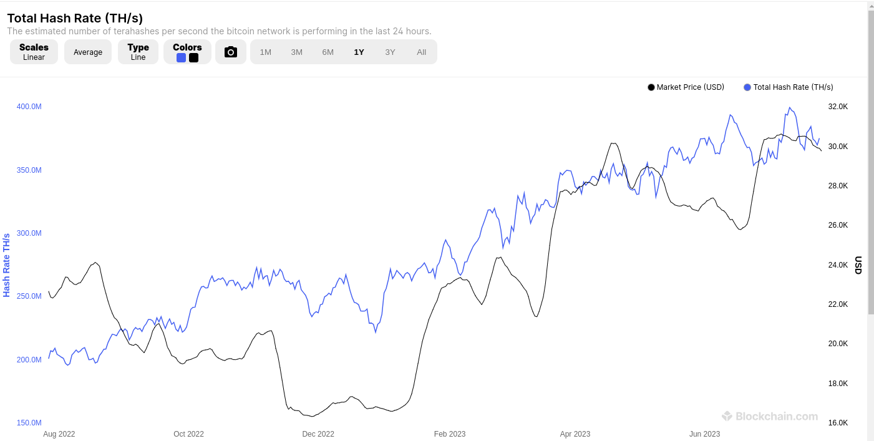
03
Secure?

Slide 11
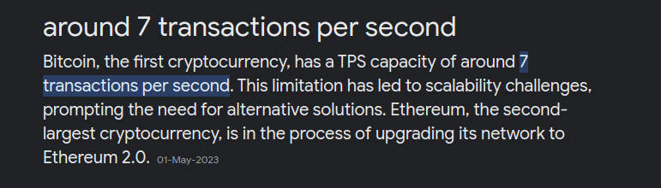

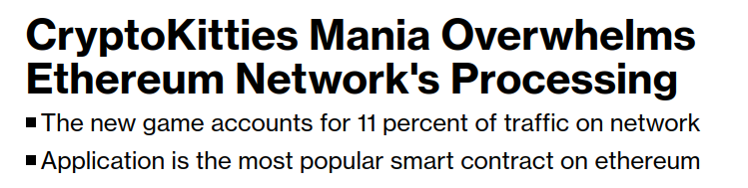
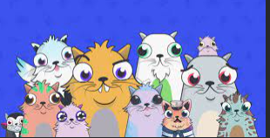
03
Scalable?

Slide 12
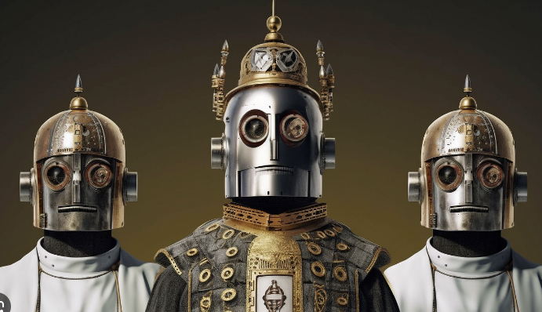
03
Summary
We need a system which is…..
Decentralized
Secure
Scalable

Slide 13
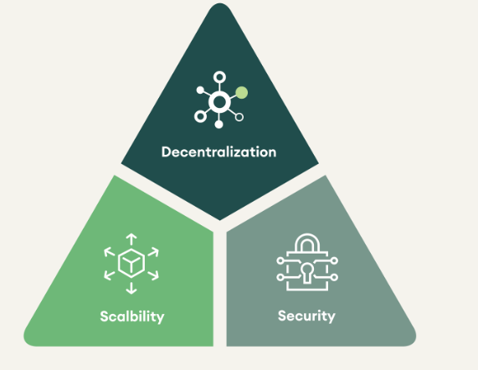
03
2. Scalabling Trilemma
Decentralised & scalable
Scalable & Secure
Secure & Decentralized

Slide 14

03
Why is scaling hard??
Latency between nodes.
Each node - re-executes transactions.
Mo transactions, mo hardware… mo bandwidth..mo latency….mo problems.
Solution
Let’s compute off-chain (L2)!
No re-execution on (L1)

Slide 15
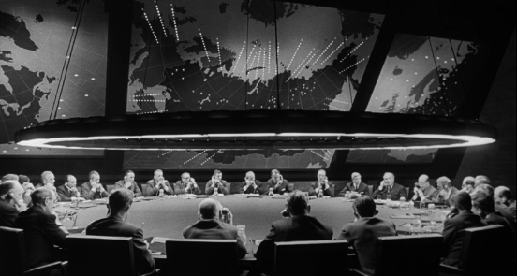
03
3. Early scaling attempts (2017-2020)
What is a Layer 1/2?
State channels.
Side chains.
Plasma.

Slide 16

03
Chotto-Matte!!
Finite resources… thus…
Security.
Frauds - Data Availability (DA).
EVM Compatible.
No Re-execution!

Slide 17
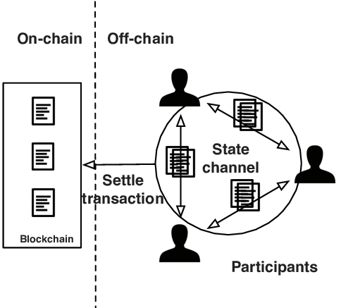
03
State channels (Lightning/RAIDEN)
Create an escrow.
Deposit money.
Exchange IOUs.
Settle on chain (Waiting..).
Works like a charm for payments..

Slide 18
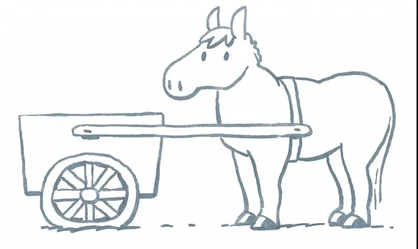
Security (Yep)
Fraud - DA (Kinda…)
EVM Compatible (err..Payments)
Drawbacks
Locked liquidity.
Challenge response/watchers.
Infrastructure.
03
State channels (contd….)

Slide 19
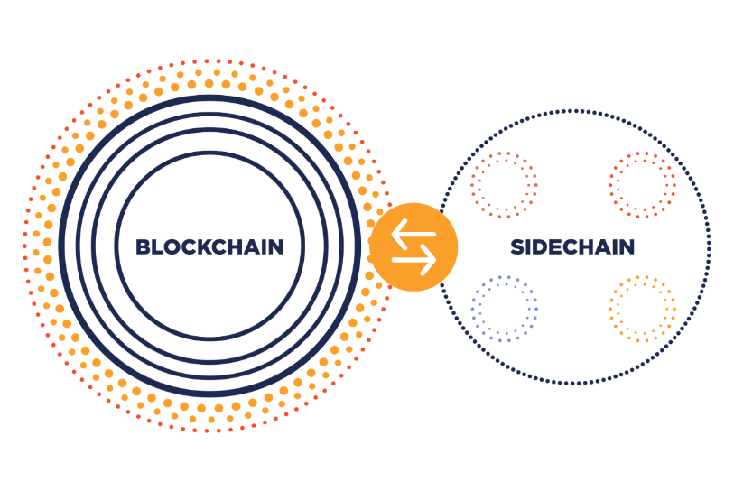
03
2. Sidechain (Polygon)
Create a new chain.
Bridge Assets.
Periodically send updates regarding state.

Slide 20
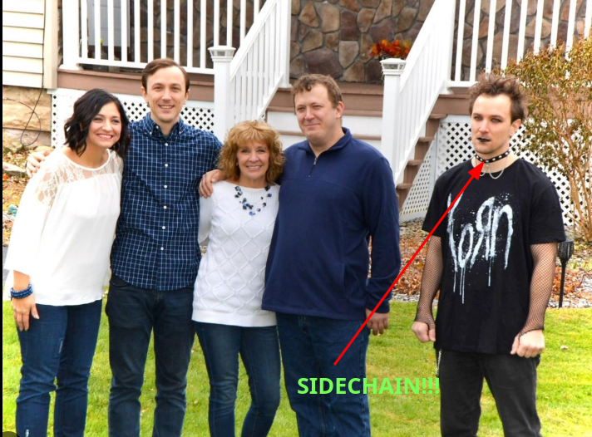
03
Sidechains (contd….)
Secure (No..Just.Trust.Me)
Fraud - DA (Nope!)
EVM Compatible (Yes)

Slide 21
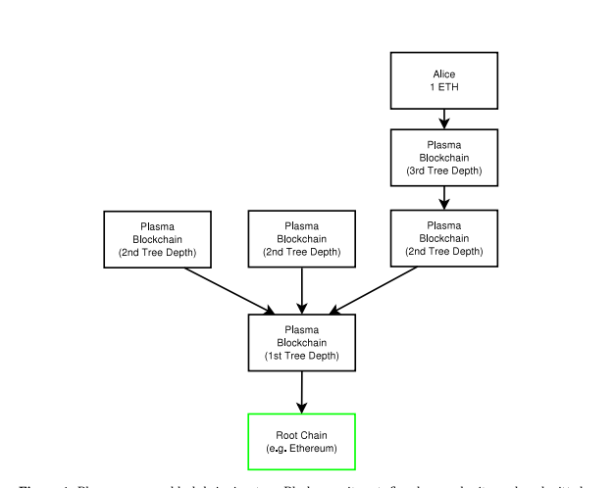
03
Plasma (OmiseGo,Polygon)
Create a new tree structure with roots on L1.
NO BRIDGING!
Periodically send updates regarding state + some DA.

Slide 22
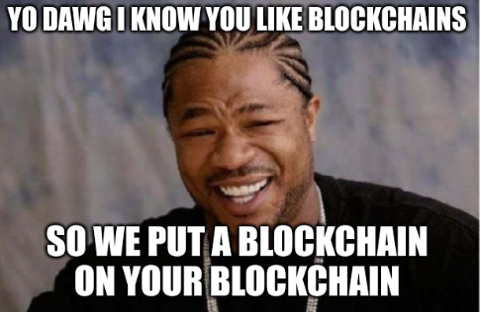
Plasma (contd….)
Secure (yes)
Fraud - DA (Erm..Kinda)
EVM Compatible (Erm… Kinda)
Drawbacks
Extremely complicated exit criteria
for frauds.
Generalizing is still hard.
This did give us Optimistic Virtual Machine (OVM).
03

Slide 23
03
Summary
 | Secure | Fraud (DA) | EVM
State Channel | Y | ? | N
Sidechain | N | N | Y
Plasma | Y | ? | ?

Slide 24
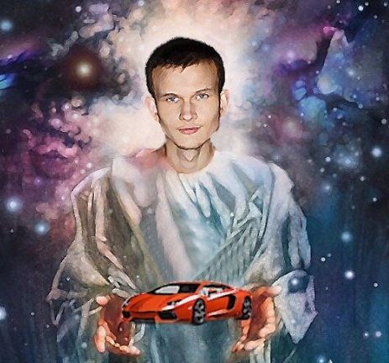
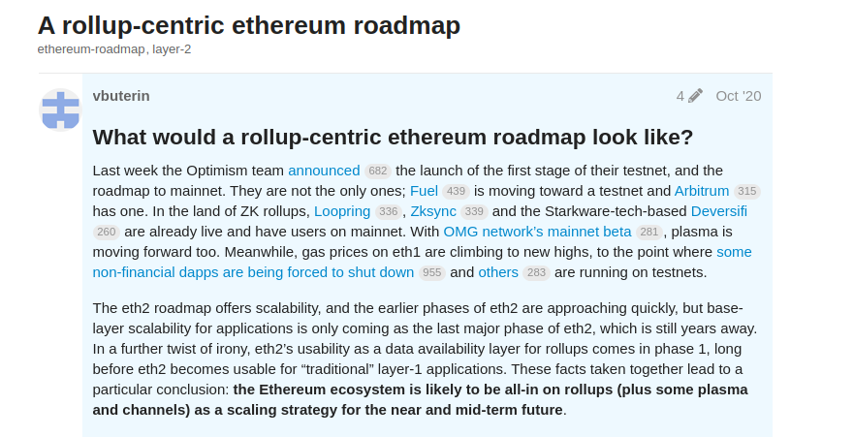
Layer 2’s
03
4. L2 : Roll ups (2020- Present)

Slide 25

03
A Detour : EVM - Fraud Detection
This is my EVM. There are many VMs like it, but this one is mine…

Slide 26
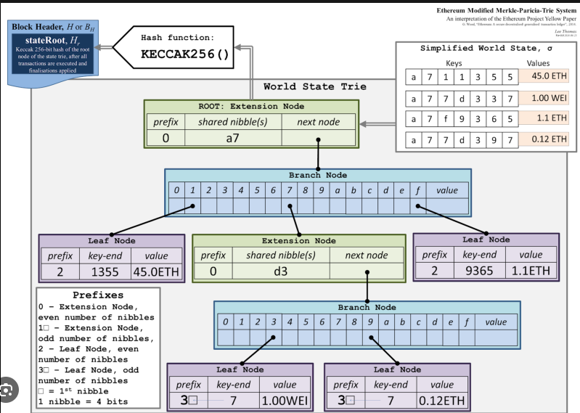
03
A Detour : EVM - Fraud Detection
What does EVM update after a transaction?
function add(5,5)
A lot apparently.
We need a way to validate state roots of L2 -> L1

Slide 27
03
A Detour : EVM - Fraud Detection
Fraud Proofs
EVM is a deterministic state machine.
May be re-play it ?
L2 Claims (Sent to L1)
Claim 1 : 5 + 5 = 10 (+ state proof)
Claim 2 : 10+ 5 = 15 (+ state proof)
Claim 3: 10 + 2 + 2 = 13 (+ state proof)

Slide 28
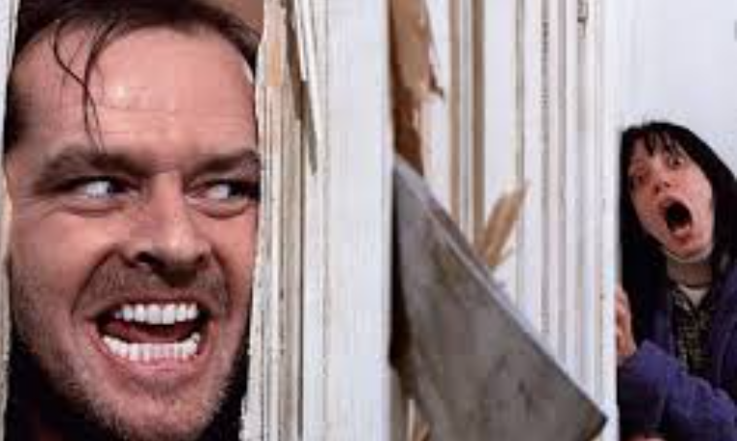
03
A Detour : EVM - Fraud Detection
Fraud Proofs (contd..)
Who wants to play?
Claim 3: 10 + 2 + 2 = 13
Put money on the table.
Challenge.
Interactive rounds.
Referred by L1 EVM.

Slide 29

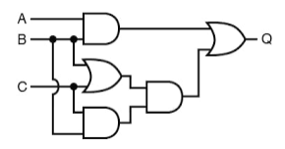
03
A Detour : EVM - Fraud Detection
Validity Proofs
Circuits represent state transition.
Provide ZK proof to L1.
Fraud? There is no fraud..may be no EVM.
Claim 3: 10 + 2 + 2 = 13 (X)

Slide 30

03
Summary
Fraud Proofs
Game theory.
Interactive rounds.
Validity Proofs
Maths.
Invalid proofs are not possible.

Slide 31
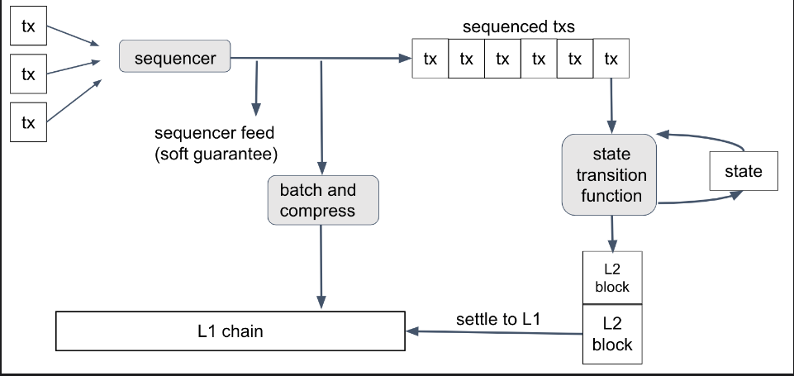
Let’s be hopeful…... Optimistic Rollup

Slide 32

03
Optimistic rollups -The happy path
1. Send transaction to Sequencer.
2. Sequencer batches the
transactions to L1. No execution!!
3. Validators create Blocks on
L2 with data read from L1. Execution.
4. Validators commit L2 blocks on L1….. but what if there is fraud??

Slide 33
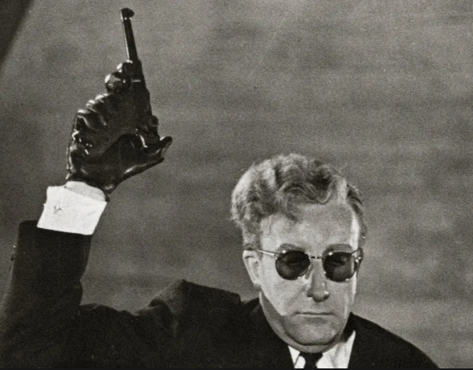
03
Optimistic Rollups - The not so happy path :
Post Bond ,Fight!
Submit Fraud Proof.
L1 EVM decides winner.
Positives
Re-use of tooling/compatibility.
Optimistic! Security!
Negatives
Exit to L1 takes longer.

Slide 34
03
Let’s just trust math …. ZK Rollup

Slide 35
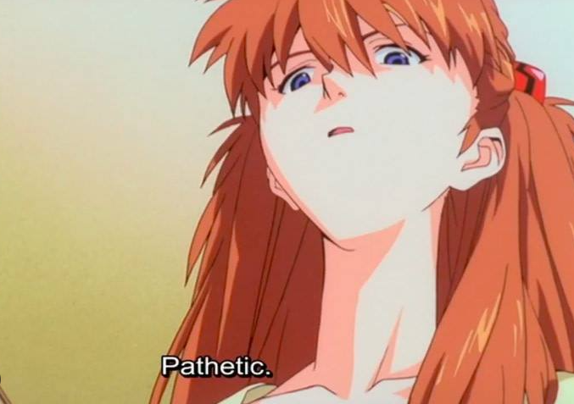
03
ZK-Rollups - Endgame.
1. Send transaction to Sequencer.
2. Sequencer batches the
transactions to L1.
3. Validators create Blocks on
L2 with data read from L1.
4. Validators submit Validity Proofs.

Slide 36
03
ZK Rollups - (contd..)
Positives
Validity proofs ensure no fraud has taken place mathematically.
Exit from chain is rapid.
Negatives
Proofs take a lot of time to generate. (4 -20+ hours).
Not compatible with EVM , result in inconsistencies, new tooling , new languages to make proving efficient.

Slide 37
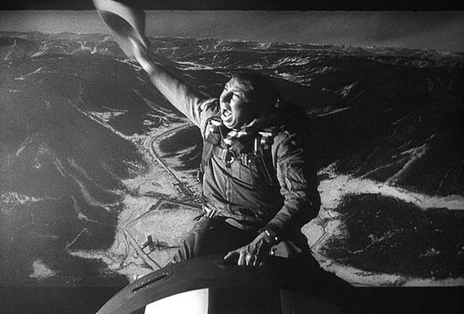
03
Yee Haw….Rollups:
L1 Security.
L1 Data availability.
L1 Fraud detection.
EVM Compatibility.

Slide 38
03
Summary
 | Secure | Fraud (DA) | EVM
State Channel | Y | ? | N
Sidechain | N | N | Y
Plasma | Y | ? | ?
Rollups | Y | Y | Y

Slide 39
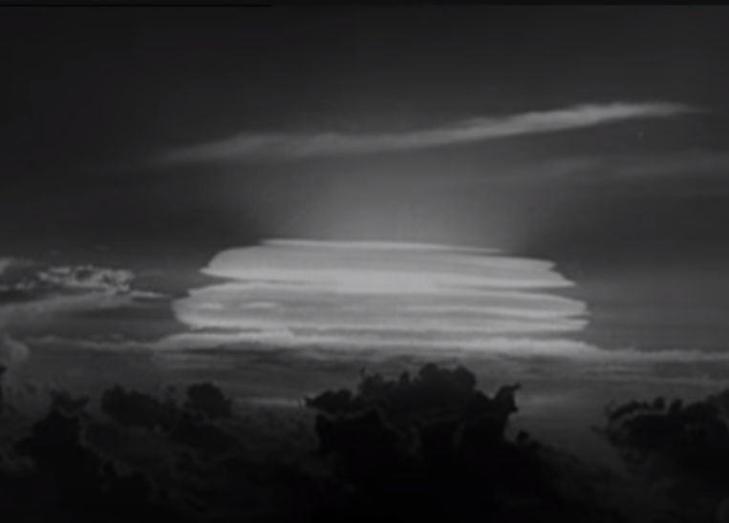
03
Optimistic Rollups
Arbitrum
Optimism
ZK-Rollups
Zk Sync
Scroll
Taiko
Starknet
Next…
Dank-sharding….

Slide 40
03
Questions!

Slide 41


Thank you
L2: or How I learnt to stop worrying about scaling and love Ethereum!! <3

